Slide 1
Kaltenbom
Dr Payal Dhawale
Dept. Of Sports Physiotherapy
MGM Institute Of Physiotherapy
Chh. Sambhajinagar

Slide 2
Orthopedic Manipulative Therapy (OMT) is an important specialty of physical therapy.
Much of OMT is devoted to the evaluation and treatment of the joint complex.
When examination reveals joint dysfunction, especially decreased range of motion (i.e., hypomobility), the joint mobilization techniques are given

Slide 3
Biomechanical approach to treatment and diagnosis
Manipulative technique has changed over the past 50 years.
Traditional manipulations applied long-lever rotational movements. The compressive forces produced by these long-lever rotational movements sometimes injured joints.
In the 1940s, James Mennell, M.D. introduced shorter lever rotational manipulations which reduced the possibility of joint damage.
In 1952 Norwegian manual therapists adopted these short- lever manipulative techniques

Slide 4
In 1954, kaltenbom introduced the concept of translatoric linear bone movements,
in the form of linear translatoric traction and gliding in relation to a treatment plane, to further reduce joint compression forces.
Over the next 30 years kaltenbom worked to incorporate translatoric joint movements into a comprehensive joint evaluation and treatment approach that reduced the need for short-lever rotation mobilizations.

Slide 5
By 1979, Evjenth and kaltenbom had refined their techniques to eliminate rotatory forces in extremity joint treatment, and by 1991 ,had accomplished the same for spinal manipulations.
In the OMT Kaltenbom-Evjenth System, biomechanical principles form the core of the analysis and treatment of musculoskeletal conditions.

Slide 6
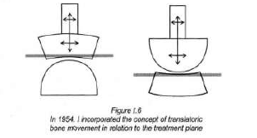
» Translatoric treatment in relation to the Kaltenbom Treatment Plane allows for safe and effective joint mobilization.

Slide 7
» The therapist evaluates the translatoric joint play movements of traction and gliding by feeling the amount of slack in the movement and sensing the end-feel. The therapist uses grades of movement to rate the amount of joint play movement they palpate.
» Three-dimensional joint positioning, carefully applied before a test or mobilization, refines and directs the movement.

Slide 8
» The Kaltenbom Convex-Concave Rule allows indirect determination of the direction of decreased joint gliding to insure normal joint mechanics during treatment.
» The therapist evaluates and treats all combinations of movements, coupled and non-coupled.
» The therapist uses specific evaluation and specific treatment, including special tests to localize symptomatic structures, and to treat hypermobility in addition to hypomobility.

Slide 9
Combination of techniques
The use of multiple treatment techniques, often in one treatment session, has always been part of our system. For example, techniques to improve joint mobility are often preceded by pain-relief and soft tissue- mobilization techniques such as functional massage and muscle stretching.

Slide 10
Self-treatment is an important part of our system and may include instruction in automobilization, autostretching, autotraction, strengthening, stabilization, or coordination exercises.
Advice on body mechanics and ergonomics is important to maintain improvements gained in therapy and to prevent recurrences.

Slide 11
Trial treatment
An experienced practitioner views any treatment procedure also as an evaluation procedure.
Kaltenbom formalized this concept within his system in 1952, with the term "trial treatment," where the manual therapist confirms the initial physical diagnosis with a low-risk trial treatment as an additional evaluation procedure

Slide 12
Ergonomic principles for the therapist
The OMT Kaltenborn-Evjenth System emphasizes good therapist body mechanics.
An example of this was my development in the 1950's of the first pneumatic high-low adjustable treatment table designed for manual physical therapy practice.

Slide 13
Their practitioners have since developed a number of treatment techniques and tools for efficiency and safety, including mobilization and fixation belts, wedges, and articulating tables

Slide 14
PRINCIPLES

Slide 15
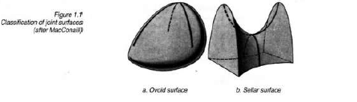
Extremity joint movement
Joint anatomy
• Articular surfaces

Slide 16
Bony connections
In most joint positions the articular surfaces are not fully congruent.
The incongruence of joint partners is due to the differences in curvature of the articular surfaces, e.g., the convex partner is more curved (smaller radius of curvature) than its concave joint partner

Slide 17
Joints have traditionally been classified only by their morphology and mechanical characteristics

Slide 18
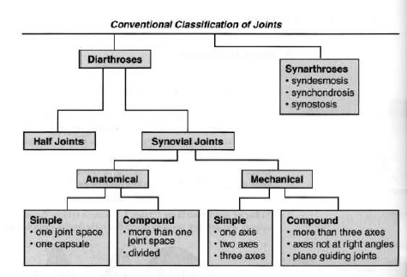

Slide 19
MacConaill's classification of joints
MacConai ll describes four structural classifications of synovial joints which are correlated with the types of bone movements and the degrees of freedom allowed at each articular pair:
» Unmodified ovoid: (art. spheroidea), ball and socket, triaxial, e.g., hip and shoulder joints
» Modified ovoid: (art. ellipsoidea), ellipsoid, biaxial, e.g., metacarpophalangeal (MCP) joints
» Unmodified sellar: (art. sellaris), saddle, biaxial, e.g., first carpometacarpal joint
» Modified sellar: (art. ginglymus), hinge, uniaxial, e.g., interphalangeal joints

Slide 20
The joint complex, anatomical and physiological joint
Anatomical Joint
The anatomical joint consists of two articular surfaces -with the surrounding joint capsule, ligaments, and intra articular structures.
These structures are classified as "inert (noncontractile) structures"
I Intra-articular joint structures
2 Extra-articular joint structure

Slide 21
Joint complex
Joint complex describes the anatomical joint plus all the surrounding soft tissues, including muscles, connective tissues, nerves and blood vessels
The neuromuscular tissues within the joint complex, including muscles, tendons, tendon insertions and innervation, are classified as "contractile structures"

Slide 22
I Intra-articular joint structures
2 Extra-articular joint structures
3 Neuromuscular tissues
4 Skin and integument

Slide 23
Anatomical planes of reference
The body is traditionally divided into three anatomical (cardinal) planes that are situated at right angles to each other and intersect at the body 's center of gravity.
These planes of reference are used for describing and measuring anatomical bone movements

Slide 24
The median plane divides the body symmetrically into right and left halves and all planes parallel to this are called sagittal planes.
Planes divide the extremities into right and left halves are called dorsal-ventral, dorsal-palmar, or dorsal-plantar planes.

Slide 25
The frontal plane divides the body into anterior (ventral) and posterior (dorsal) halves.
Planes dividing the extremities into anterior and posterior halves are called medial-lateral, radialulnar, or tibial-fibular planes.

Slide 26
The transverse plane or horizontal plane divides the body into cranial and caudal halves and the extremities into distal and proximal halves

Slide 27
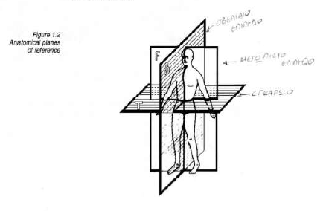

Slide 28
Kaltenbom Treatment Plane
The Kaltenbom Treatment Plane passes through the joint and lies at a right angle to a line running from the axis of rotation in the convex bony partner, to the deepest aspect of the articulating concave surface.
For practical purposes, you can quickly estimate where the treatment plane lies by imagining that it lies on the concave articular surface.

Slide 29
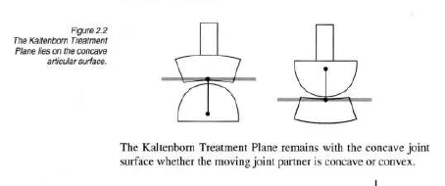

Slide 30
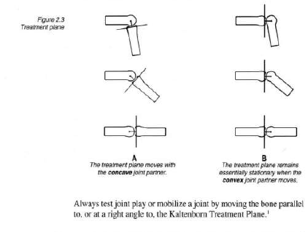

Slide 31
Anatomical axes of reference
The anatomical axes lie at the intersection of two anatomical planes and anatomical bone movements take place around these axes.
The frontal axis lies at the intersection of the frontal and transverse planes and runs from right to left. In the extremities, this axis is called transverse, medial-lateral, radial-ulnar, or tibial-fibular

Slide 32
The sagittal axis lies at the intersection of the sagittal and transverse planes and runs in a dorsal-ventral direction.
The longitudinal (vertical) axis lies at the intersection of the sagittal and frontal planes and runs in a cranial-caudal direction. In the extremities, this axis passes through a part of a bone such as the neck of the femur or the entire length of a bone e.g., the shaft of the humerus, clavicle

Slide 33
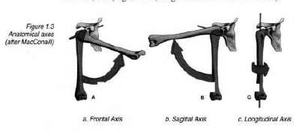

Slide 34
Three-dimensional joint positioning
The effectiveness of joint evaluation and mobilization treatment can be enhanced by placing the joint specifically in one, two, or three planes. For practical purposes,
classify joint positions into five categories:
» Zero position
» Resting position (Loose-packed position)
» Actual resting position
» Non resting positions
» Close-packed position

Slide 35
Zero position
All joint range of motion measurements are taken from the zero starting position, if possible. The range of motion is measured with a goniometer on both sides of zero.

Slide 36
For example, a movement of thirty degrees flexion and ten degrees extension is written: flexion/extension 30-0-10.
However, if there is limitation of movement, with movement only possible on the flexion side of zero, both figures are written on the left side of zero as in flexion extension 30-10-0 .

Slide 37
Resting position
The resting position (loose-packed position) is the position (usually three-dimensional) where periarticular structures are most lax, allowing for the greatest range of joint play With many joint conditions, this position is also the patient's position of comfort (symptom-relieving posture) affording the most relaxation and least muscle tension.

Slide 38
The resting position is useful for:
» evaluating joint play through its range of motion, including end-feel, and diagnostic manipulations.
» treating symptoms with Grade I-II traction mobilization within the slack.
» treating hypomobility with Grade II relaxation-mobilization or Grade III stretch-mobilization and manipulations.
» to minimize secondary joint damage due to long periods of immobilization associated with casting and splinting.

Slide 39
Nonresting positions
Many subtle joint dysfunctions only become apparent when the joint is examined outside the resting position (nonresting position) and can only be treated in such positions. Other nonresting positions are used to specifically position soft tissues for movement or stretch.
Since nonresting positions allow less joint play, more skill is required to perform techniques safely in these positions.
Novice practitioners applying stretch mobilizations in nonresting positions are more likely to overstretch tissues and cause injury.

Slide 40
Close-packed position
The close-packed position is characterized by the following criteria:
» The joint capsule and ligaments are tight or maximally tensed.
» There is maximal contact between the concave and convex articular surfaces. For example, the shoulder is closepacked when it is positioned in maximal extension and external rotation .
» Articular surface gliding is maximally reduced and only slight separation with traction forces is possible. Joint play testing and mobilization is difficult to perform at or near the close-packed position.

Slide 41
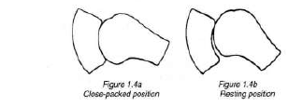

Slide 43
Bone and joint movement
Bone movements produce associated joint movements. The relation ship between a bone movement (osteokinematics) and its associated joint movements (arthrokinematics) forms the basis for many orthopedic manual therapy (OMT) evaluation and treatment techniques.

Slide 44
Two types of bone movements are important in kalternbom OMT system:
Rotations: curved (angular) movement around an axis
Translations: linear (straight-lined) movement parallel to an axis in one plane

Slide 45
Rotations of bone produce the joint movement of roll-gliding.
Translations of bone result in the linear joint play movements of traction , compression, and gliding in relation to the Kaltenborn Treatment Plane. From a mechanical perspective, translations can be curved or linear

Slide 46
Bone movements Corresponding joint movements
Rotatoric (angular) movement Roll-gliding
· Standard (anatomical, uniaxial)
· Combined (functional, multiaxial)
Translatoric (linear) movement Translatoric joint play
· Longitudinal bone separation · Traction
away from the treatment plane
· Longitudin al bone approximation · Compression
towards the treatment plane
· Transverse bone movement · Gliding parallel to the treatment plane

Slide 47
Rotations of a bone
Active movements occur around an axis and therefore, from a mechanical viewpoint, are considered rotations.
All bone rotations can be produced passively as well. There are two types of bone rotations:
1) Standard, uniaxial - MacConaill 's "pure, cardinal swing"
2) Combined, multiaxial - MacConaill 's "impure arcuate swing"

Slide 48
Standard bone movements
Standard bone movements are bone rotations occurring around one axis (uniaxial) and in one plane.
Standard movement is called "anatomical" movement when the movement axis and the movement plane are in anatomical (or cardinal) planes.
Anatomical bone movements beginning at the zero position are useful for describing and measuring test movements.
They provide a standardized method for communicating examination findings that can be reproduced by other health care professionals

Slide 49
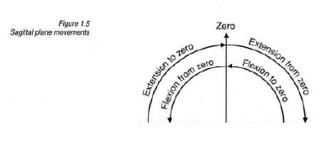
Sagittal plane movements around a frontal axis
» Flexion from zero:
» Extension to zero:
» Extension from zero:
» Flexion to zero:

Slide 50
Frontal plane movements around a sagittal axis
» Right and left side bending: trunk or spinal movements occur in the frontal plane.
» Abduction: movements are away from the median or sagittal planes.
» Adduction: movements are towards the median or sagittal planes.

Slide 51
Transverse plane movements around a longitudinal axis
The term rotation can be used to describe movement of a bone around its' longitudinal (vertical) axis or an axis parallel to a longitudinal axis.
A similar movement, torsion describes movement of bones in relationship to one another around an axis approximately parallel to their longitudinal axis, for example pronation and supination of the forearm.

Slide 52
Right and left rotation: trunk or spinal movements in the transverse plane
Medial and lateral rotation: movement of the extremities around longitudinal axes of bones

Slide 53
Combined bone movements
The Extremities Bone movement that occurs simultaneously around more than one axis (multiaxial) and in more than one plane is called combined, or functional, movement.
For example, simultaneous knee extension with rotation is a combined movement. These movements do not occur purely in cardinal planes and around stationary axes, but rather in oblique or diagonal directions.

Slide 54
Combined movements represent most of the movements we carry out during daily activities.
Manual therapists often examine combined movements in order to reproduce a patient's chief complaint and to analyze mechanisms of injury.

Slide 55
Combined movements are further classified as coupled and noncoupled movements according to the degree and nature of movement ease possible when flexion or extension and rotation are combined in various ways
Coupled movements have the greatest ease (greatest range and softest end-feel), for example, knee extension with external rotation. Noncoupled movements have less ease (less range and a harder end-feel), for example, knee extension with internal rotation.

Slide 56
Joint roll-gliding associated with bone rotations
Joint roll-gliding
In a healthy joint, functional movement (bone rotation) produces joint roll-gliding. Roll-gliding is a combination of rolling and gliding movement which takes place between two joint surfaces

Slide 57
If a concave surface moves, joint gliding and bone movements are in the same direction. The moving bone and its concave joint surface are both on the same side of the axis of movement.
If a convex joint surface is moving, joint gliding and distal bone movement are in opposite directions. In this case, the distal aspect of the moving bone and its convex articular surface are on opposite sides of the movement axis.

Slide 58
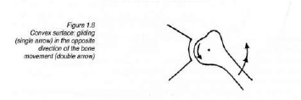
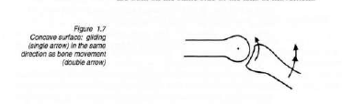

Slide 59
Translation of a bone
Bone translation in OMT is a linear movement of a bone along a defined axis in its respective plane. During pure translation of a bone, all parts of the bone move in a straight line, equal distances, in the same direction , and at the same speed.
Bone translation can be performed only in very small increments.
Depending on the direction of the movement, bone translation can be described as parallel movement along a particular axis.

Slide 60
Bone translation
Longitudinal Axis Bone Translation
» Separation of adjacent joint surfaces, pulling them away from each other
» Approximation of adjacent joint surfaces, pushing them toward each other

Slide 61
Sagittal Axis Bone Translation
» Ventral-Dorsal Gliding: parallel movement of adjacent bones in relation to each other in a ventral or dorsal direction

Slide 62
Frontal Axis Bone Translation
» Lateral Gliding: parallel movement of adjacent bones in relation to each other to the right or left

Slide 63
Joint play associated with bone translation
Translatoric joint play Bone translations produce isolated traction, compression, or gliding joint play movements in relation to the treatment plane.
These translatoric joint play movements are essential to the easy, painless performance of active movement

Slide 64
Translatoric joint play

Slide 65
Translatoric joint play
In the OMT Kaltenbom-Evjenth system we use trans latoric (linear) joint play movements in relation to the treatment plane in both evaluation and treatment.
Kaltenbom-Evjenth apply translatoric traction , compression and gliding joint play movements to evaluate joint function.
Kaltenbom-Evjenth apply translatoric gliding and traction mobilizations to restore joint play.

Slide 66
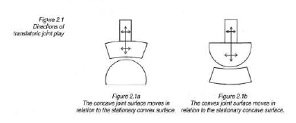

Slide 67
Translatoric joint play movements
The translatoric joint play movements used in the OMT Kaltenbom-Evjenth System are traction, compression, and gliding.
Kaltenbom-Evjenth define traction, compression, and gliding joint play movements in relation to the Kaltenbom Treatment Plane.

Slide 68
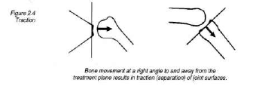
Traction
Traction (separation) is a linear translatoric joint play movement at a right angle to and away from the treatment plane.

Slide 69
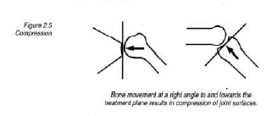
Compression
Compression (approximation) is a linear translatoric movement at a right angle to and toward the treatment plane.
Compression presses the joint surfaces together. Joint compression can be useful as an evaluation technique to differentiate between articular and extra- articular lesions.

Slide 70
Gliding
Bone movement at a right angle to and towards the treatment plane results in compression of Joint surfaces.
Translatoric gliding is a joint play movement parallel to the treatment plane.
Translatoric gliding is possible over a short distance in all joints because curved joint surfaces are not perfectly congruent.

Slide 71
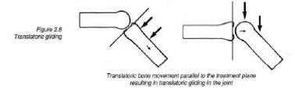

Slide 72
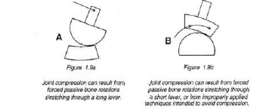
Abnormal roll-gliding
With movement restrictions (hypomobility) normal joint roll-gliding is often disturbed.

Slide 73
Joint rolling movements in the absence of gliding can produce a damaging concentration of forces in a joint. On the same side towards which the bone is moving, joint surfaces tend to compress and pinch intra articular structures, which can cause injury.
At the same time, on the side opposite the bone movement, tissues can be overstretched.

Slide 74
Determining the direction of restricted gliding
There are two methods of determining the direction of restricted joint gliding: I) the glide test, and 2) the Kaltenborn ConvexConcave Rule .

Slide 75
• Glide test (the direct method)
Apply passive translatoric gliding movements in all possible directions and determine in which directions joint gliding is restricted.
The glide test is the preferred method because it gives the most accurate information about the degree and nature of a glidingrestriction, including its end-feel.

Slide 76
• Kaltenborn Convex-Concave Rule (the indirect method)
First determine which bone rotations are decreased and whether the moving joint partner is convex or concave. Then deduce the direction of decreased joint gliding by applying the Convex Concave Rule.

Slide 77
CONVEX ... OPPOSITE CONCAVE ... SAME
The Kaltenbom Convex-Concave Rule is based on the relationship between normal bone rotations and the gliding component of the corresponding joint movements (roll-gliding).

Slide 78
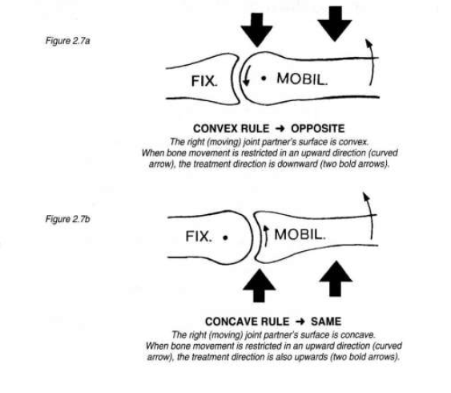

Slide 79
Grades of translatoric movement
The translatoric movements of traction and gliding are divided into three grades. These grades are determined by the amount of joint slack (looseness and resistance) in the joint that you feel when performing passive joint play movements .

Slide 80
Normal grades of translatoric movement
I-III scale
Your ability to correctly perform translatoric movements depends on your skill in feeling when there is slack in the joint and when the tissues that cross the joint become tightened. Joint play movements are greatest, and therefore easiest to produce and palpate, in a joint's resting position, where the joint capsule and ligaments are most lax.

Slide 81
A Grade I " loosening" movement is an extremely small traction force which produces no appreciable increase in joint separation.
Grade I traction nullifies the normal compressive forces acting on the joint.

Slide 82
A Grade II ''tightening'' movement first takes up the slack in the tissues surrounding the joint and then tightens the tissues.
In the Slack Zone (SZ) at the beginning of the Grade II range there is very little resistance to passive movement.
Further Grade II movement into the Transition Zone (TZ) tightens the tissues and the practitioner senses more resistance to passive movement. Approaching the end of the Grade II range the practitioner feels a marked resistance, called the First Stop.

Slide 83
A Grade III "stretching" movement is applied after the slack has been taken up and all tissues become taut (beyond the Transition Zone). At this point, a Grade III stretching force applied over a sufficient period of time can safely stretch tissues crossing the joint. Resistance to movement increases rapidly within the Grade III range

Slide 84
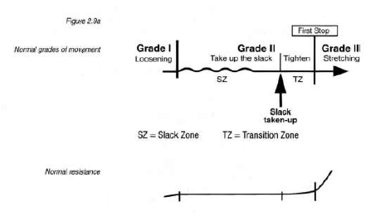

Slide 85
Pathological grades of translatoric movement
In the presence of joint pathology, the quality of end-feel is altered and grades of movement may be altered as well. For example, in the presence of a marked hypomobility the slack is taken up sooner than normal and greater force may be necessary to nullify intraarticular compression forces.

Slide 86
In hypermobility the slack is taken up later than normal and less force may be necessary to achieve Grade I traction.

Slide 87
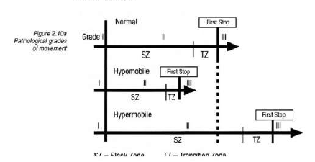

Slide 88
Using translatoric grades of movement
Grade I
» Relieve pain with vibratory and oscillatory movements.
» Grade I traction is used simultaneously with glide tests and glide mobilizations to reduce or eliminate compression force and pain.

Slide 89
Grade II
» Test joint play traction and glide movements.
» Relieve pain. (Treatment takes place in the Slack Zone not in the Transition Zone.)

Slide 90
    » Increase or maintain movement, for example when pain or muscle spasm limits movement in the absence of shortened tissue. (Relaxation mobilization can be applied within the entire Grade n range, including the Transition Zone.)

Slide 91
Grade III
» Test joint play end-feel.
» Increase mobility and joint play by stretching shortened tissues with slow or quick mobilisation.

Slide 92
Indications
Restricted joint play (hypomobility) and an abnormal end-feel
In patients with hypomobility due to muscle spasm in the absence of tissue shortening, relaxation mobilizations in tbe Grade I – II range are generally effective.

Slide 93
In the presence of excessive joint play (hypermobility), stabilizing (limiting) measures are indicated and Grade III stretch mobilization is contraindicated.

Slide 94
contraindications
Grade I and II "within-the-slack" mobilizations are seldom contraindicated, but many contraindications exist for Grade III stretch mobilizations.

Slide 95
General contraindications to Grade III stretch mobilization
relate primarily to health problems that reduce the body 's tolerance to mechanical forces and therefore increase the risk of injury from stretch mobilization treatment. For example:

Slide 96
» pathological changes due to neoplasm, inflammation, infections, or osteopenia (e.g., osteoporosis, osteomalacia)

Slide 97
» active collagen vascular disorders
» massive degenerative changes
» loss of skeletal or ligamentous stability in the spine (e.g., secondary to inflammation or infection or after trauma)
» certain congenital anomalies

Slide 98
» anomalies or patbological changes in vessels
» coagulation problems (e.g., anticoagulation factors,hemophilia)
» dermatological problems aggravated by skin contact and open or healing skin lesions

Slide 99
Contraindications
Specific contraindications to Grade III stretch mobilization
techniques include:
» decreased joint play with a hard, nonelastic end-feel in a hypomobile movement direction

Slide 100
» increased joint play with a very soft, elastic end-feel in a hypermobiJe movement direction
» pain and protective muscle spasm during mobilization
» positive screening tests Screening tests identify conditions that contraindicate specific mobilization techniques and should be completed prior to treatment.

Slide 101
For joint play testing including end-feel (Grade r - III), move
slowly and ease into the Grade III range;
» For pain relief (Grade I- IlSZ), use oscillations or slow, repetitive, intermittent traction movements, staying well short of the Transition Zone;
» For relaxation (Grade I - IITZ), apply slow intermittent traction mobilizations, staying well short of the First Stop;

Slide 102
» For stretching (Grade III), apply linear traction or glide movements even more slowly and sustain each stretch for 30 – 40 seconds or more.
For the longest lasting effect, repeat the stretch in a cyclic manner for a 10 - 15 minute session or to patient tolerance. Note that home exercise is usually necessary to maintain the mobility gains.

